Slide 1
Chapter 6 An Overview of Organic Reactions

Slide 2
Learning Objectives
(6.1)
Kinds of organic reactions
(6.2)
How organic reactions occur: Mechanisms
(6.3)
Radical reactions
(6.4)
Polar reactions

Slide 3
Learning Objectives
(6.5)
An example of a polar reaction: Addition of HBr to ethylene
(6.6)
Using curved arrows in polar reaction mechanisms
(6.7)
Describing a reaction: Equilibria, rates, and energy changes

Slide 4
Learning Objectives
(6.8)
Describing a reaction: Bond dissociation energies
(6.9)
Describing a reaction: Energy diagrams and transition states
(6.10)
Describing a reaction: Intermediates
(6.11)
A comparison between biological reactions and laboratory reactions

Slide 5
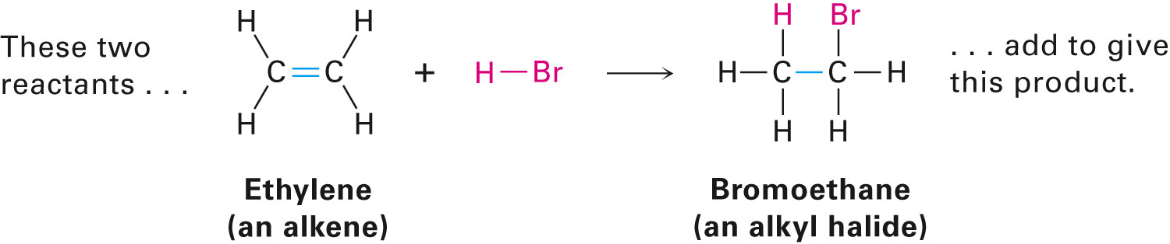
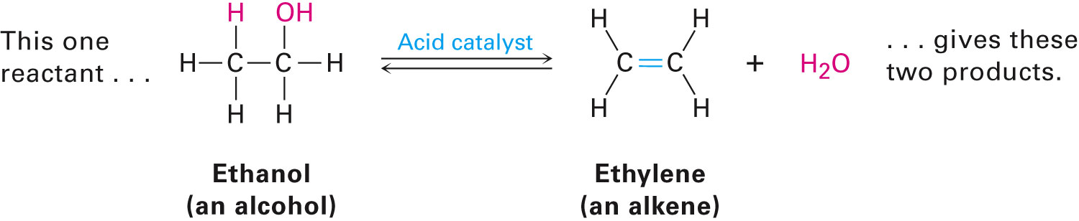
Kinds of Organic Reactions
Addition reactions: Two reactants combining to form a single product
Elimination reactions: Single reactant splitting into two products
Notes:
Kinds of organic reactions

Slide 6
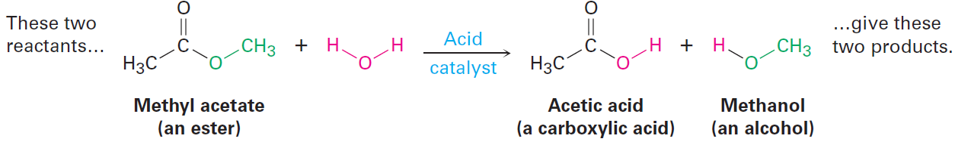
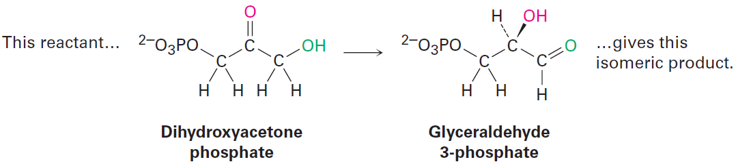
Kinds of Organic Reactions
Substitution reactions: Two reactants exchanging parts to form two new products
Rearrangement reactions: Single reactant yielding an isomeric product through reorganization of its bonds and atoms
Notes:
Kinds of organic reactions

Slide 7
Worked Example
Classify each of the following reactions as an addition, elimination, substitution, or rearrangement
a)CH₃Br + KOH → CH₃OH + KBr
b) CH₃CH₂Br → H₂C═CH₂ + HBr
c) H₂C═CH₂ + H₂ → CH₃CH₃
Solution:
a)CH₃Br + KOH → CH₃OH + KBr (Substitution)
b) CH₃CH₂Br → H₂C═CH₂ + HBr (Elimination)
c) H₂C═CH₂ + H₂ → CH₃CH₃ (Addition)
Notes:
Kinds of organic reactions

Slide 8
How Organic Reactions Occur: Mechanisms
Reaction mechanism: Overall description of a reaction process
Reactions occur in defined steps that lead from reactant to product
Must account for all reactants and products
Chemical reactions involve bond-breaking and bond-making
Notes:
How organic reactions occur: Mechanisms

Slide 9
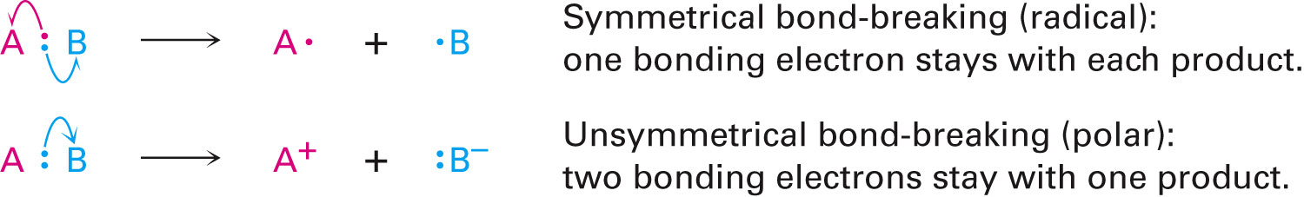
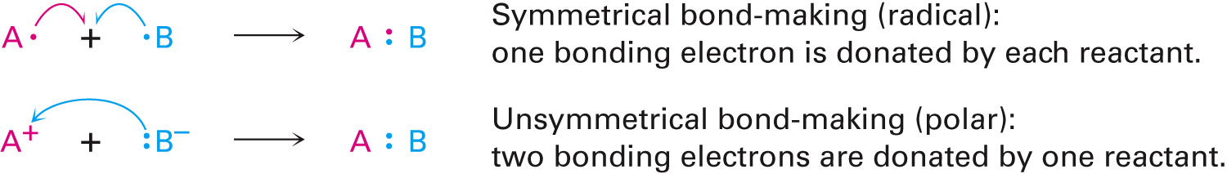
How Organic Reactions Occur: Mechanisms
Bond formation or breakage can be symmetrical or unsymmetrical
Symmetrical cleavage - Homolytic
Unsymmetrical cleavage - Heterolytic
Notes:
How organic reactions occur: Mechanisms

Slide 10
How Organic Reactions Occur: Mechanisms
Curved arrows indicate breaking and forming of bonds
Arrowheads with a half head (fish-hook) indicate movement of one electron in the symmetrical process
Arrowheads with a complete head indicate movement of two electrons in the unsymmetrical process
Notes:
How organic reactions occur: Mechanisms

Slide 11
How Organic Reactions Occur: Mechanisms
Radical reactions: Processes that involve symmetrical bond-breaking and bond-making
Radical: Neutral chemical species containing odd number of electrons
Has a single, unpaired electron in one of its orbitals
Polar reactions: Processes involving unsymmetrical bond-breaking and bond-making
Notes:
How organic reactions occur: Mechanisms

Slide 12
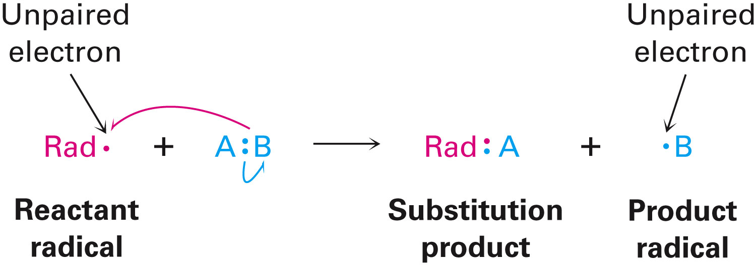
Radical Reactions
Not as common in comparison to polar reactions
Radicals react to complete electron octet of valence shell
A radical can add to an alkene to give a new radical, causing an addition reaction
Notes:
Radical Reactions

Slide 13

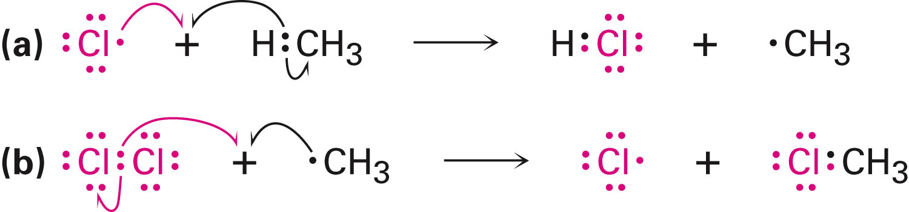
Radical Reactions
Steps required for methyl chlorination
Initiation
Propagation
Reaction with molecule to generate radical
Notes:
Radical Reactions

Slide 14
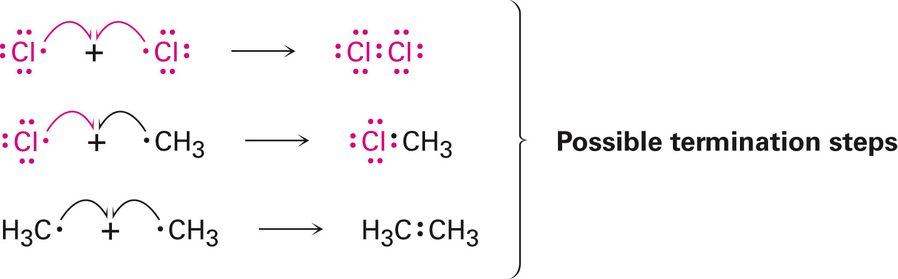
Radical Reactions
Termination
Combination of two radicals to form a stable product
Notes:
Radical Reactions

Slide 15
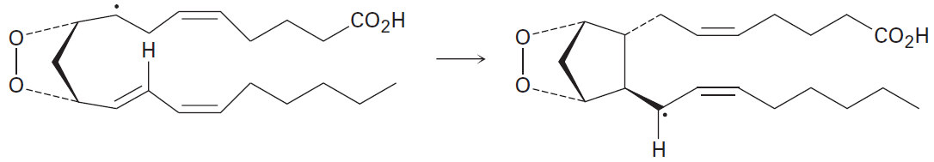
Worked Example
Using curved fishhook arrows, propose a mechanism for the formation of the cyclopentane ring of prostaglandin H₂
Notes:
Radical Reactions

Slide 16
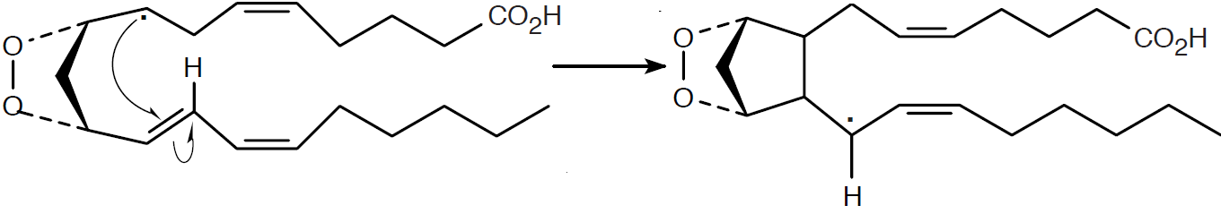
Worked Example
Solution:
The tails of the arrows show the location of the bond to be broken
The heads show where the electrons are moving
The reaction is a radical addition to a double bond
It is a rearrangement
Notes:
Radical Reactions

Slide 17
Polar Reactions
Molecules can contain local unsymmetrical electron distributions
Causes bond polarity
Bonds in functional groups are polar
Carbon atoms bonded to electronegative atoms have a partial positive charge
Carbon atoms bonded to metals have a partial negative charge
Notes:
Polar Reactions

Slide 18
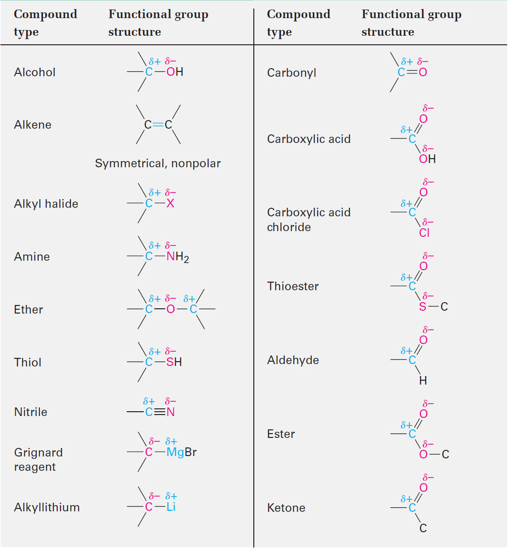
Table 6.1 - Polarity Patterns in Some Common Functional Groups
Notes:
Polar Reactions

Slide 19
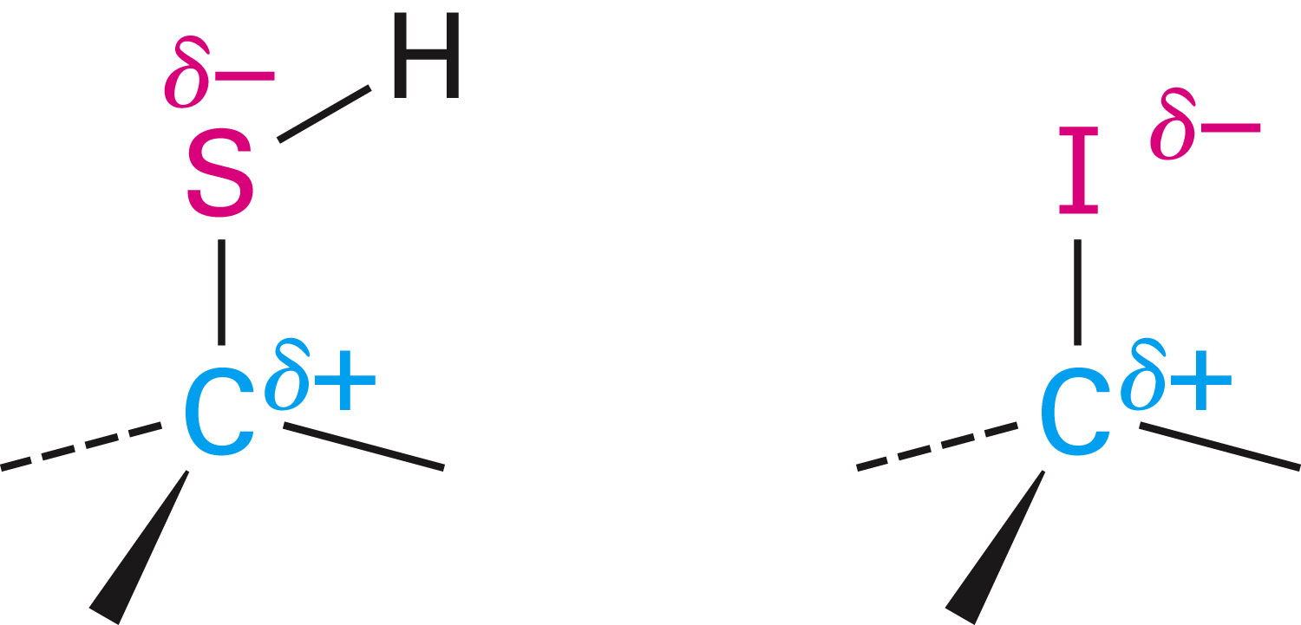
Polar Reactions
Polarizability: Tendency of atoms in a molecule to undergo polarization
Larger atoms, easily polarizable
Smaller atoms, less polarizable
Notes:
Polar Reactions

Slide 20
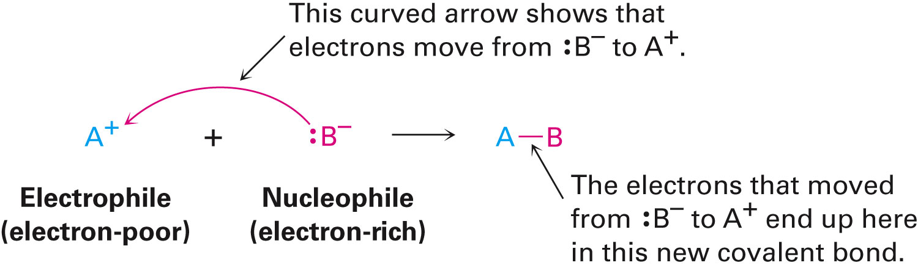
Polar Reactions
Nucleophile: Electron-rich species that donate electron pairs to electrophile in a polar bond-forming reaction
Is a Lewis base
Electrophile: Substances that accept electron pairs from a nucleophile
Is a Lewis acid
Notes:
Polar Reactions

Slide 21
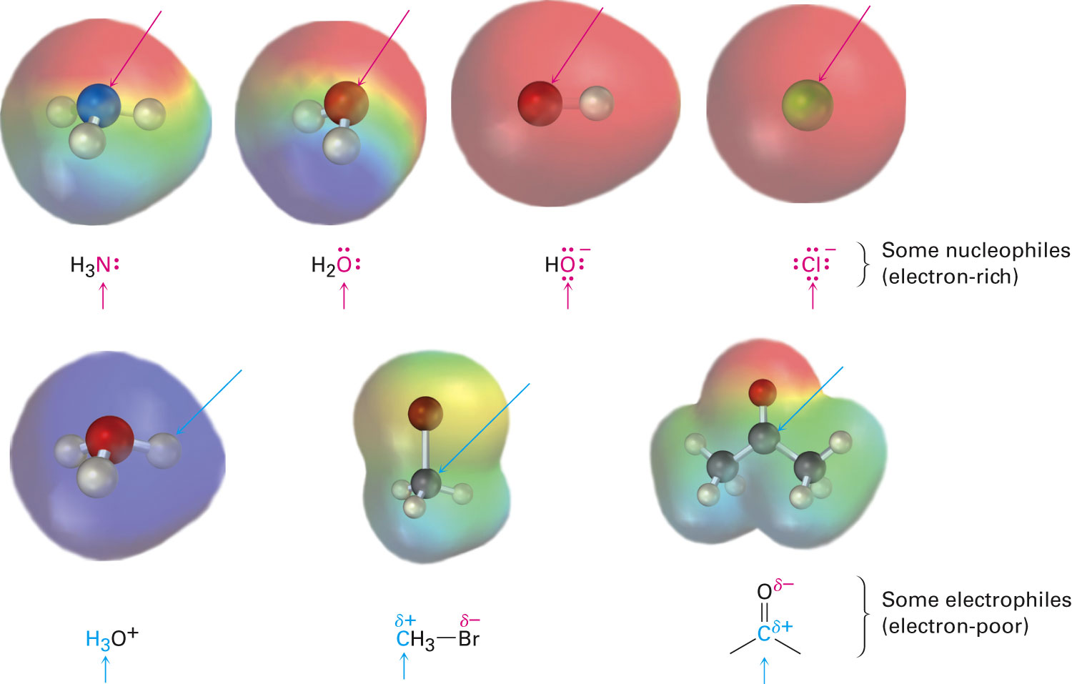
Figure 6.1 - Some Nucleophiles and Electrophiles
Notes:
Polar Reactions

Slide 22
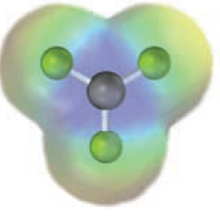
Worked Example
An electrostatic potential map of boron trifluoride is shown
Is BF₃ likely to be a nucleophile or an electrophile?
Draw a Lewis structure for BF₃
Notes:
Polar Reactions

Slide 23
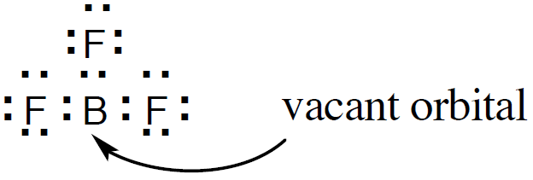
Worked Example
Solution:
The electrostatic potential map indicates that it is electron-poor (blue)
BF₃ is likely to be an electrophile
Lewis structure
Notes:
Polar Reactions

Slide 24
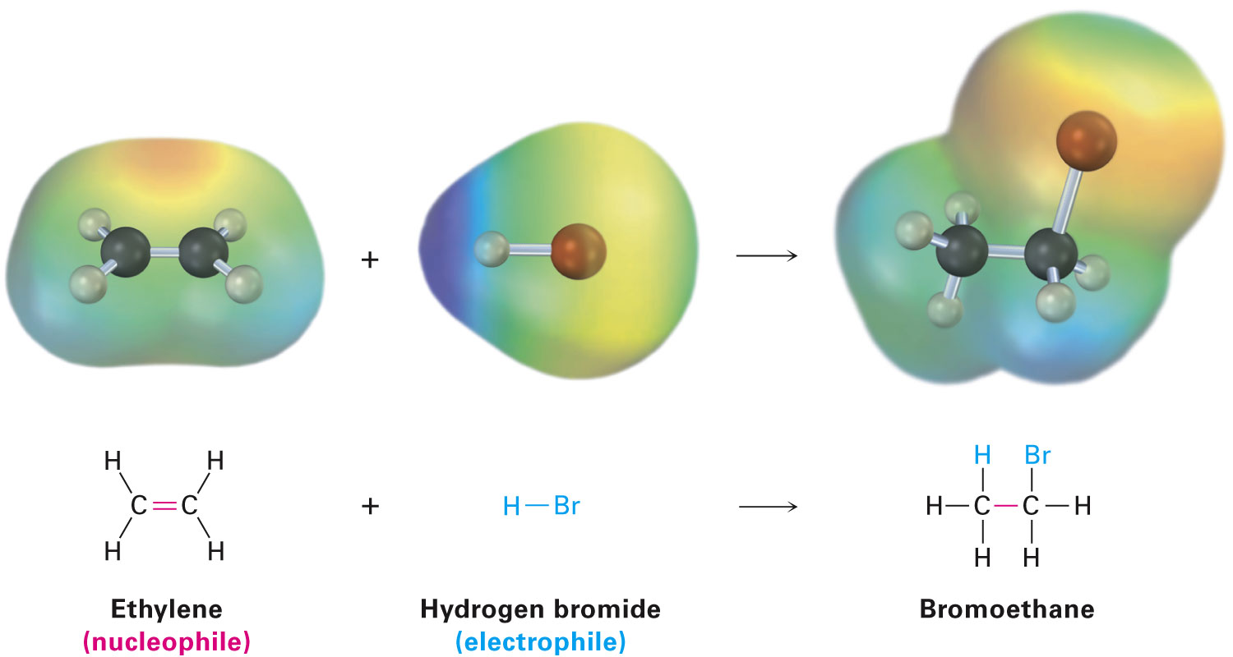
An Example of a Polar Reaction: Addition of HBr to Ethylene
Electrophilic addition reaction
π part results from p–p overlap
σ results from sp²–sp² overlap
Double bond is more accessible to approaching reactants than a single bond
More electron-rich
Notes:
An Example of a PolarReaction: Addition of HBr to Ethylene

Slide 25
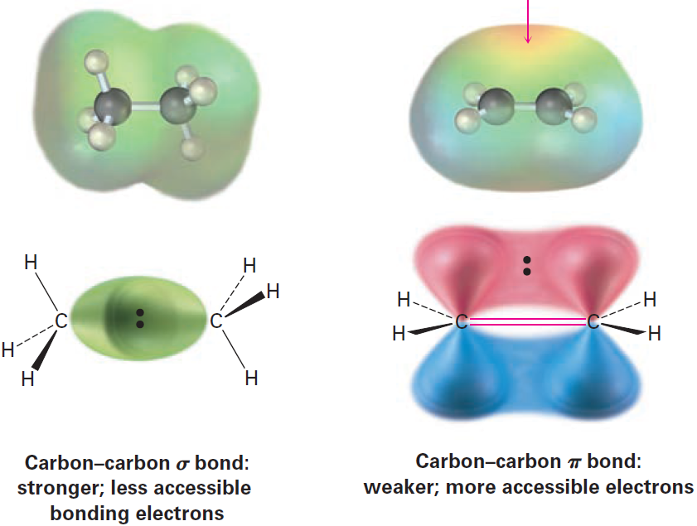
Figure 6.2 - A Comparison of Carbon–Carbon Single and Double Bonds
Notes:
An Example of a PolarReaction: Addition of HBr to Ethylene

Slide 26
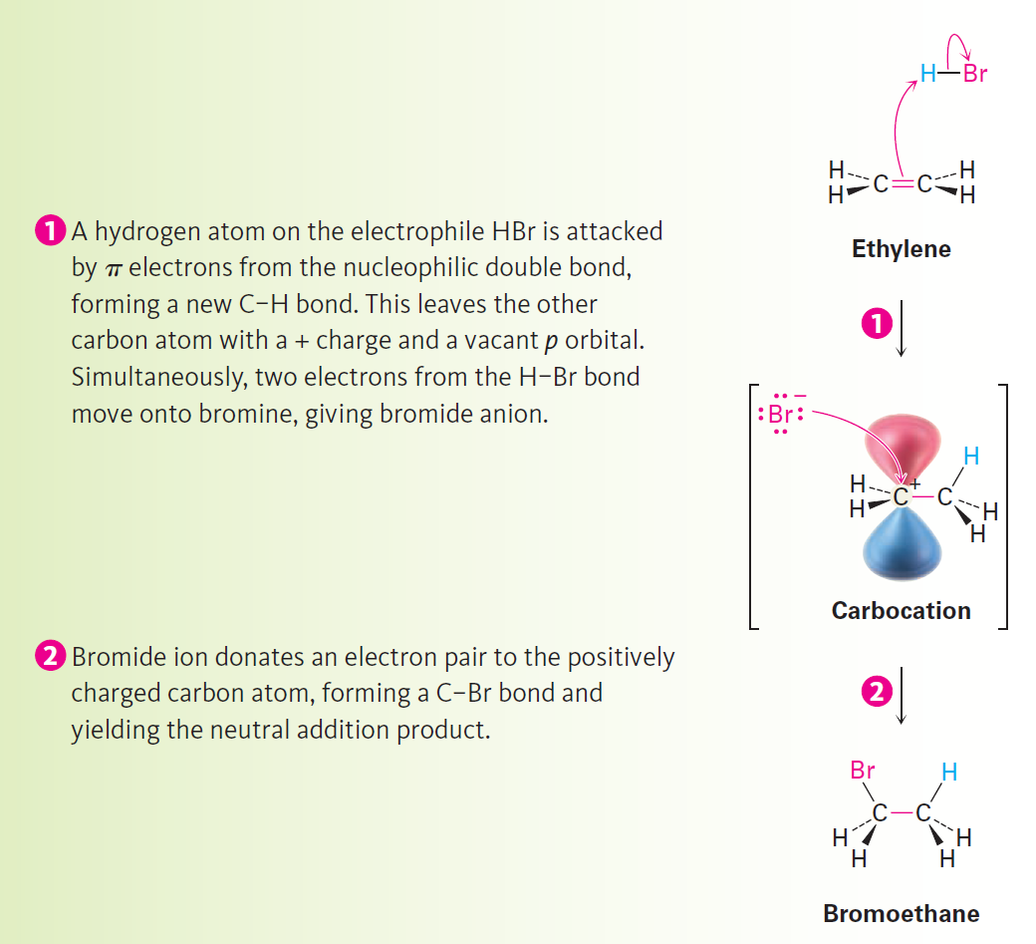
Figure 6.3 - Mechanism
Notes:
An Example of a PolarReaction: Addition of HBr to Ethylene

Slide 27
Mechanism of Addition of HBr to Ethylene
Polar reactions occur by combination of an electron-rich site of a nucleophile and an electron-deficient site of an electrophile
Carbocation: Substance that contains a trivalent, positively charged carbon atom having six electrons in its outer shell
Notes:
An Example of a PolarReaction: Addition of HBr to Ethylene

Slide 28
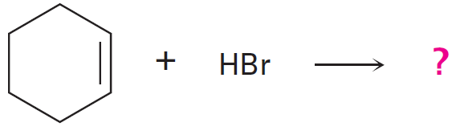
Worked Example
What product would you expect from reaction of cyclohexene with HBr and HCl?
Solution:
Reaction is an electrophilic addition reaction
Halogen acid adds to a double bond to produce a haloalkane
Notes:
An Example of a PolarReaction: Addition of HBr to Ethylene

Slide 29
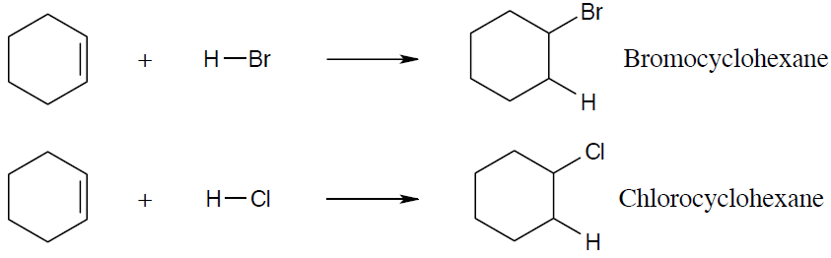
Worked Example
Notes:
An Example of a PolarReaction: Addition of HBr to Ethylene

Slide 30
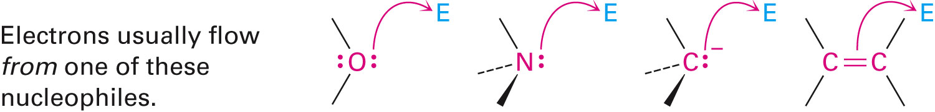
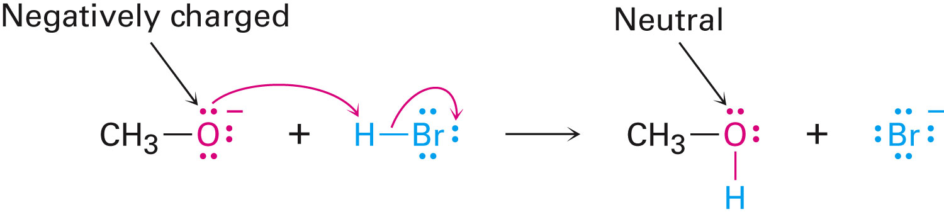
Rules for Using Curved Arrows
Electrons move from a nucleophilic source to an electrophilic sink
The nucleophilic site can be neutral or negatively charged
Notes:
Using curved arrows in polar reaction mechanisms

Slide 31
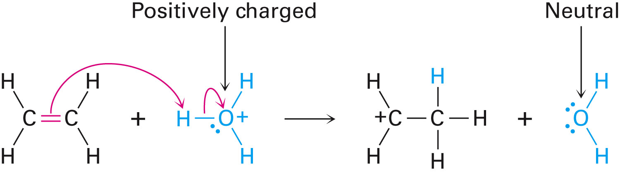
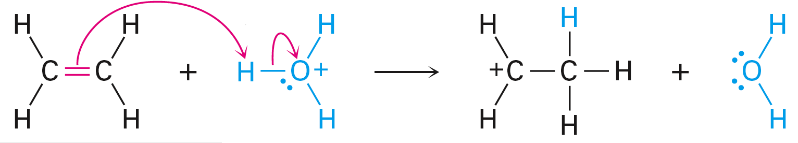
Rules for Using Curved Arrows
The electrophilic site can be neutral or positively charged
The octet rule should be followed
Notes:
Using curved arrows in polar reaction mechanisms

Slide 32
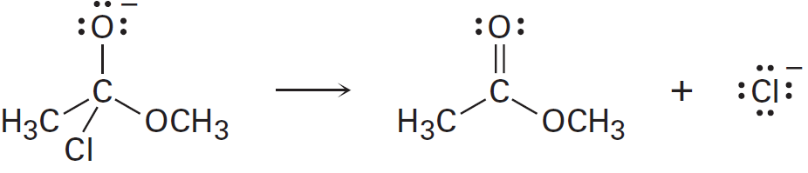
Worked Example
Add curved arrows to the following polar reaction to indicate the flow of electrons
Notes:
Using curved arrows in polar reaction mechanisms

Slide 33
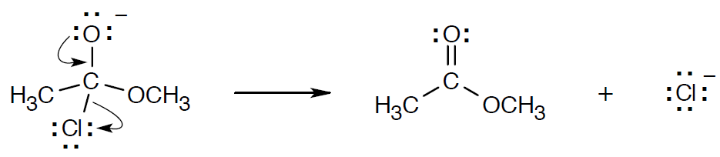
Worked Example
Solution:
A double bond forms between oxygen and carbon
C–Cl bond is broken
Electrons move from oxygen to form the double bond and from carbon to chlorine
Notes:
Using curved arrows in polar reaction mechanisms

Slide 34
Describing a Reaction: Equilibria, Rates, and Energy Changes
To reach equilibrium, reactions go in either forward or reverse directions
The multiplied concentrations of the products divided by the multiplied concentrations of the reactant is the equilibrium constant, K_{eq}
Each concentration is raised to the power of its coefficient in the balanced equation
Notes:
Describing a reaction: Equilibria, rates, and energy changes

Slide 35
Describing a Reaction: Equilibria, Rates, and Energy Changes
If value of K_{eq} is > 1
Indicates that product concentration term is larger than the reactant concentration term
Reaction takes place from left to right
If K_{eq} is 1
Quantity of reactant and product present at equilibrium is large
If value of K_{eq} is < 1
Reaction takes place in the reverse direction
Notes:
Describing a reaction: Equilibria, rates, and energy changes

Slide 36
Describing a Reaction: Equilibria, Rates, and Energy Changes
Gibbs free energy (ΔG): Change in energy that occurs during a chemical reaction
ΔG = G_{products} - G_{reactants}
Energy is released on the favored side of an equilibrium reaction
Exergonic: Reaction that has negative free energy change and is therefore spontaneous
Energy is lost
Endergonic: Reaction that has positive free energy change
Energy is absorbed
Notes:
Describing a reaction: Equilibria, rates, and energy changes

Slide 37
Describing a Reaction: Equilibria, Rates, and Energy Changes
Standard free energy change at 1 atm pressure and 298 K is denoted as ΔG°
Relationship between free energy change and an equilibrium constant is:
ΔG° = - RT ln K_{eq}
Where,
R = 1.987 cal/(K · mol)
T = Temperature in Kelvin
ln K_{eq} = Natural logarithm of K_{eq}
Notes:
Describing a reaction: Equilibria, rates, and energy changes

Slide 38
Describing a Reaction: Equilibria, Rates, and Energy Changes
Enthalpy change (ΔH): Measure of change in total bonding energy during a reaction
Called heat of reaction
Exothermic: Reaction that releases heat
Endothermic: Reaction that absorbs heat
Entropy change (ΔS): Measure of the change in the amount of molecular randomness
K_{eq} tells the position of the equilibrium
Amount of product that is theoretically possible
Notes:
Describing a reaction: Equilibria, rates, and energy changes

Slide 39
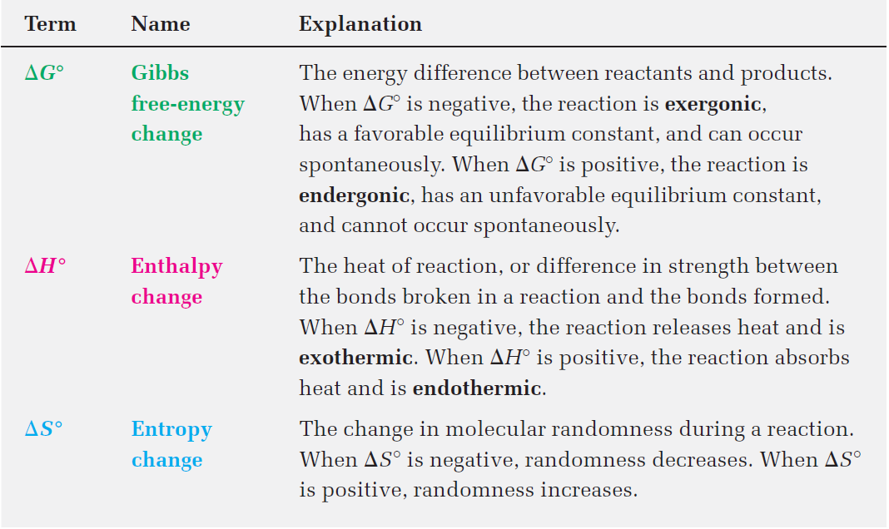
Table 6.2 - Explanation of Thermodynamic Quantities: ΔG°= Δ H°- T Δ S°
Notes:
Describing a reaction: Equilibria, rates, and energy changes

Slide 40
Worked Example
Which reaction is likely to be more exergonic, one with K_{eq} = 1000 or one with K_{eq} = 0.001?
Solution:
ΔG° = -RT ln K_{eq}
Large K_{eq} is related to a large negative ΔG°
A favorable reaction
Therefore, a reaction with Keq = 1000 is more exergonic than a reaction with Keq = 0.001
Notes:
Describing a reaction: Equilibria, rates, and energy changes

Slide 41

Describing a Reaction: Bond Dissociation Energies
Bond dissociation energy (D): Amount of energy required to break a given bond to produce two radical fragments when the molecule is in the gas phase at 25˚ C
Energy is determined by the type of bond
Changes in bonds can be used to calculate net changes in heat
Notes:
Describing a reaction: Bond dissociation energies

Slide 42
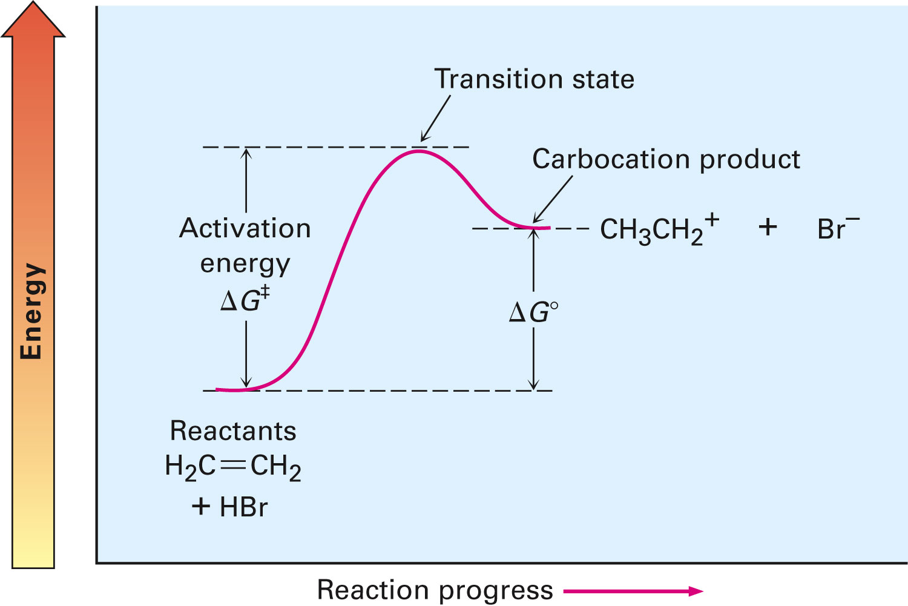
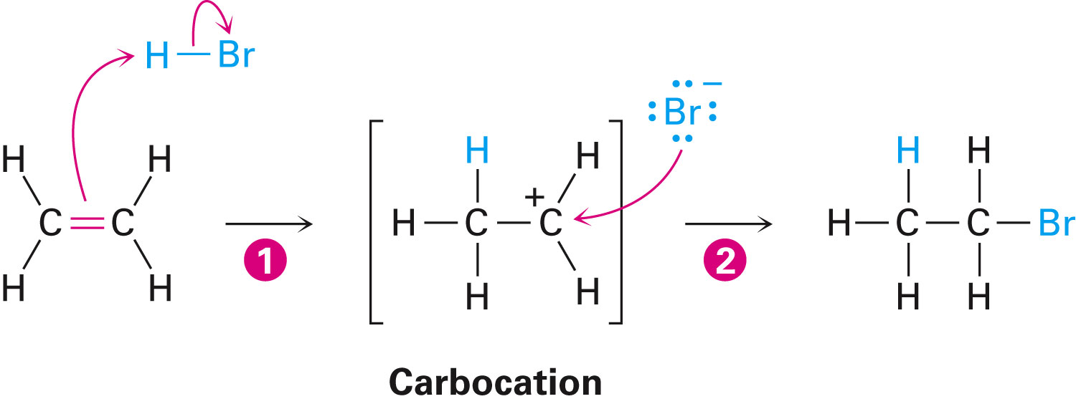
Describing a Reaction: Energy Diagrams and Transition States
Transition state: Highest energy point in a reaction step
Activation energy, ΔG‡: Energy required to go from reactant to transition state
Notes:
Describing a reaction: Bond dissociation energies

Slide 43
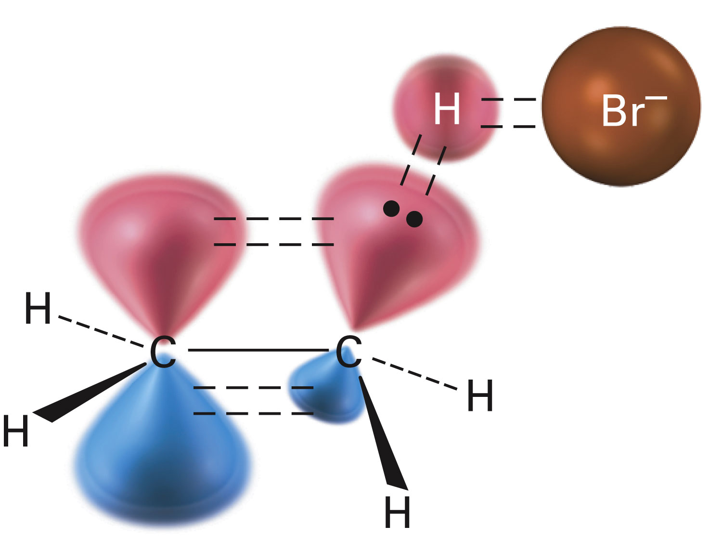
Describing a Reaction: Energy Diagrams and Transition States
In the addition of HBr
Transition-state structure for the first step
π bond between the carbons begins to break
C–H bond is partially formed
H–Br bond begins to break
Notes:
Describing a reaction: Bond dissociation energies

Slide 44
Describing a Reaction: Energy Diagrams and Transition States
Once the transition state is reached the reaction may:
Continue to give the carbocation product
Revert back to reactants
Every reaction has its own energy profile
Notes:
Describing a reaction: Energy diagrams and transition states

Slide 45
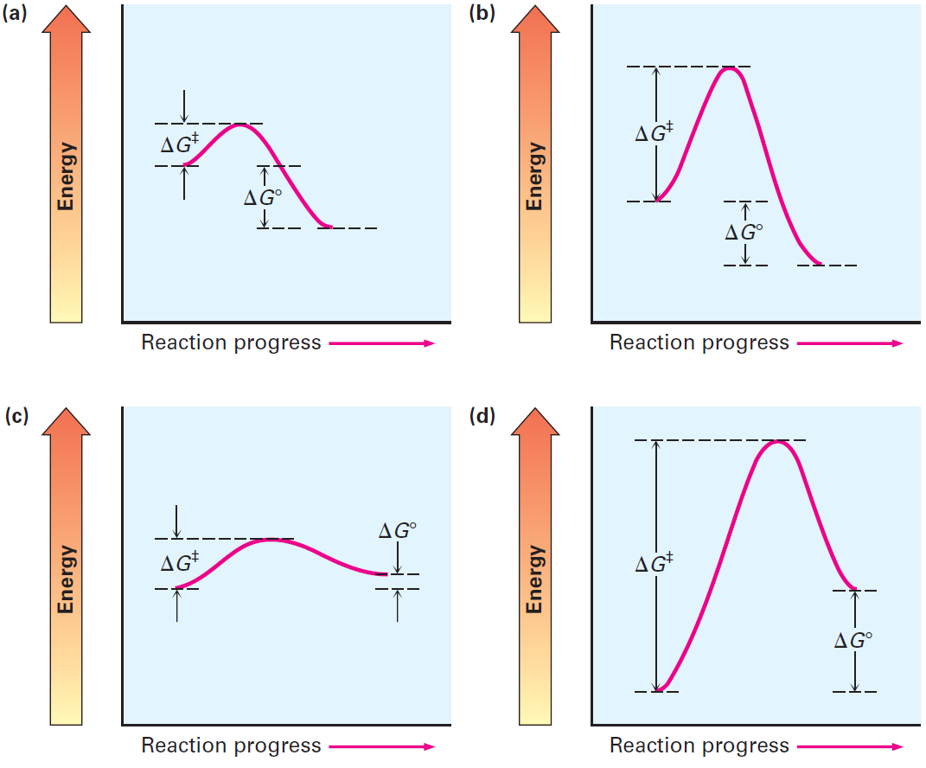
Figure 6.6 - Some Hypothetical Energy Diagrams
Notes:
Describing a reaction: Energy diagrams and transition states

Slide 46
Worked Example
Which reaction is faster, one with ΔG‡ = +45 kJ/mol or one with ΔG‡ = +70 kJ/mol?
Solution:
Larger value for ΔG‡ indicates a slower reaction
Therefore, reaction with ΔG‡ = +45 kJ/mol is faster than a reaction with ΔG‡ = +70 kJ/mol
Notes:
Describing a reaction: Energy diagrams and transition states

Slide 47
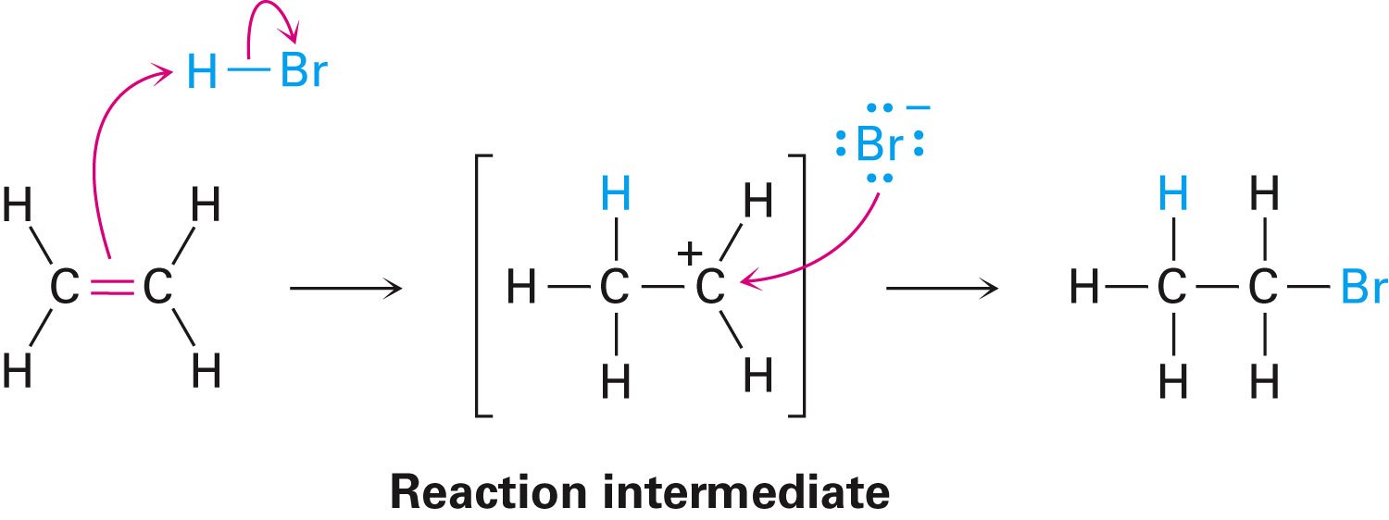
Describing a Reaction: Intermediates
If a reaction occurs in more than one step, it must involve species that are neither the reactant nor the final product
Called reaction intermediate
Each step has its own free energy of activation
Notes:
Describing a reaction: Intermediates

Slide 48
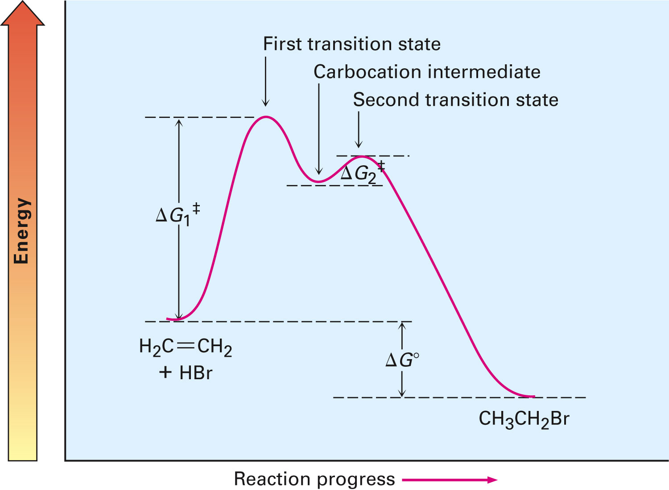
Figure 6.7 - An Energy Diagram for the Reaction of Ethylene with HBr
Notes:
Describing a reaction: Intermediates

Slide 49
Worked Example
Sketch an energy diagram for a two-step reaction in which both steps are exergonic
Second step has a higher-energy transition state than the first
Label the parts of the diagram corresponding to reactant, product, intermediate, overall ΔG‡, and overall ΔG°
Notes:
Describing a reaction: Intermediates

Slide 50
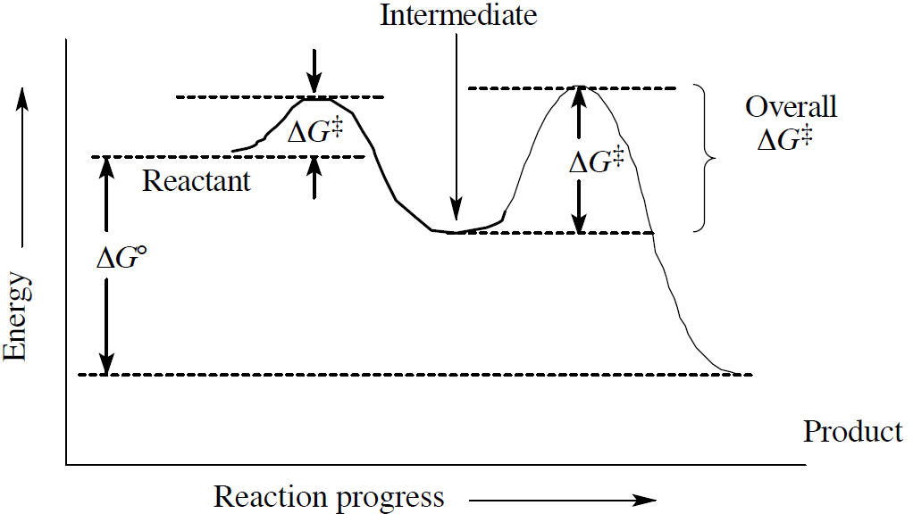
Worked Example
Solution:
Notes:
Describing a reaction: Intermediates

Slide 51
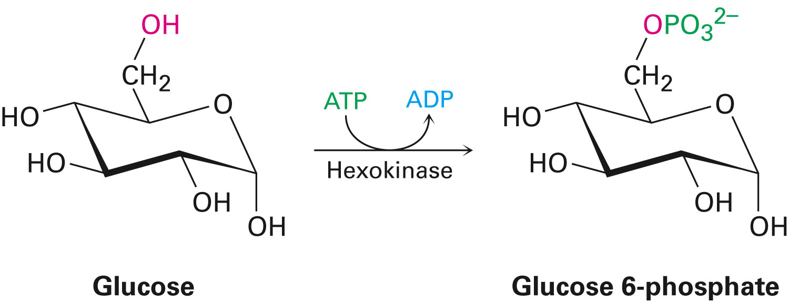
Comparison Between Biological Reactions and Laboratory Reactions
Laboratory reactions are often carried out in an organic solvent
Biological reactions occur in an aqueous medium inside cells
Active site: Pocket in an enzyme where a substrate is bound and undergoes reaction
Notes:
A comparison between biological reactions and laboratory reactions

Slide 52
Comparison Between Biological Reactions and Laboratory Reactions
Laboratory reactions
Often done using relatively simple reagents
Catalyst might be used
Biological reactions
Involve relatively complex reagents called coenzymes
Enzymes provide an alternative mechanism that makes life possible
Notes:
A comparison between biological reactions and laboratory reactions

Slide 53
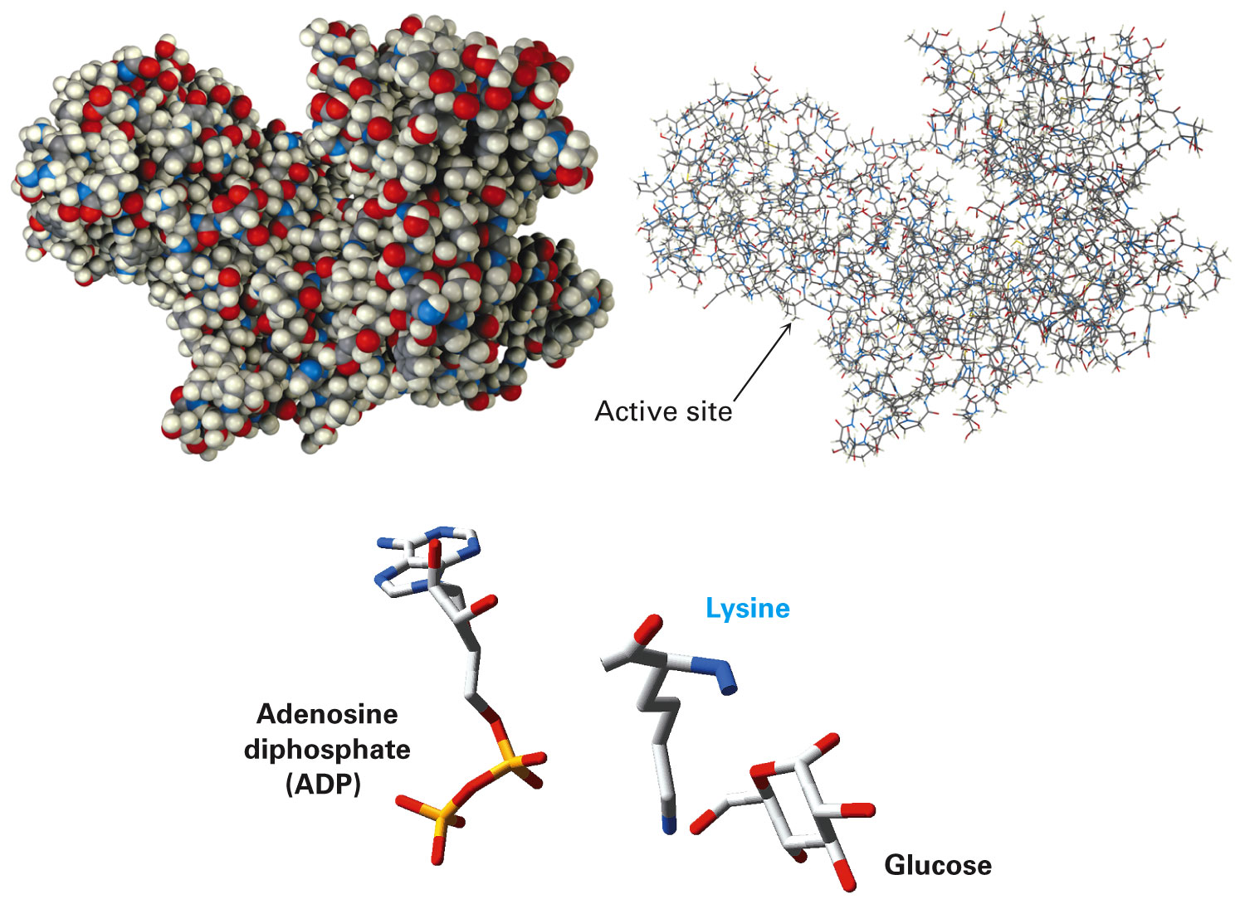
Figure 6.9 - Models of Hexokinase in Space-filling and Wire-frame Formats
Notes:
A comparison between biological reactions and laboratory reactions

Slide 54
Summary
Common kinds of reactions: Addition reactions, elimination reactions, substitution reactions, and rearrangement reactions
Mechanism describes of how a reaction occurs
Mechanisms by which most reactions take place: radical and polar
Polar reactions occur due to an attractive interaction between a nucleophilic site in one molecule and an electrophilic site in another

Slide 55
Summary
Position of a chemical equilibrium is determined by the value of the free-energy change (ΔG)
Enthalpy (ΔH) corresponds to the net change in strength of chemical bonds broken and formed during the reaction
Entropy (ΔS) corresponds to the change in the amount of molecular randomness during the reaction
Exergonic reactions are that have negative values of ΔG, release energy

Slide 56
Summary
Reactions that have positive values of ΔG and absorb energy are endergonic
Transition state is an activated complex occurring at the highest-energy point of a reaction
Amount of energy needed by reactants to reach this high point is the activation energy, ΔG‡
Reactions take place in more than one step and involve the formation of a reaction intermediate

